Slide 1

Notes:
Title

Slide 2
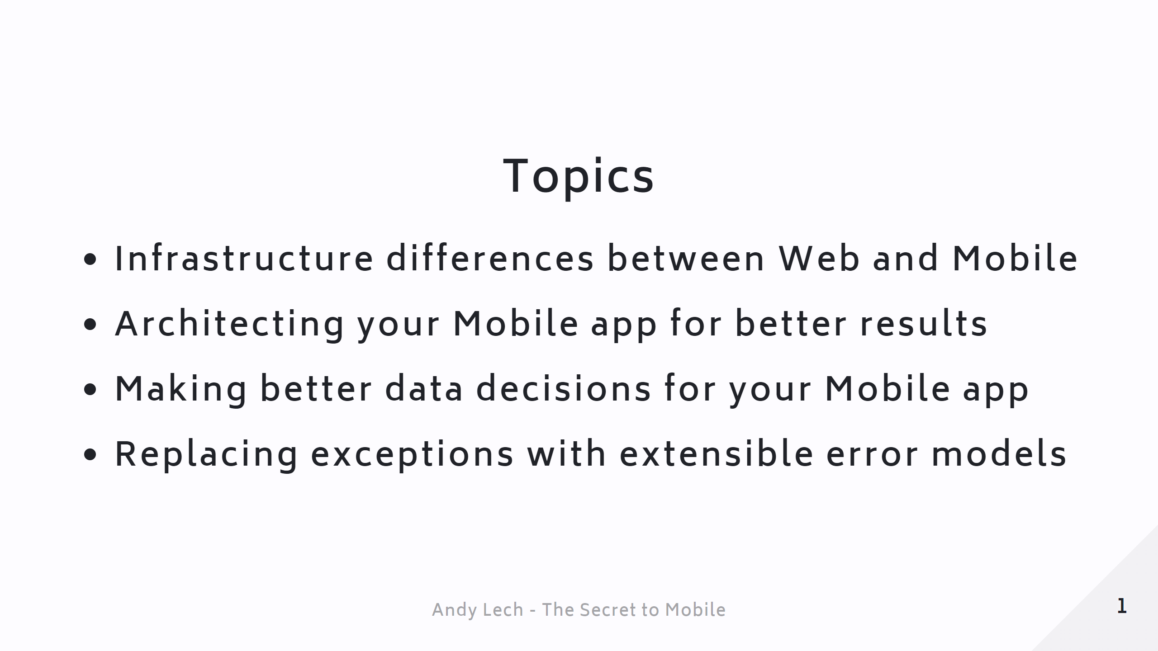
Notes:
Sponsors ### ![height:550px](./images/conferences) --- Page 0 - Topics

Slide 3
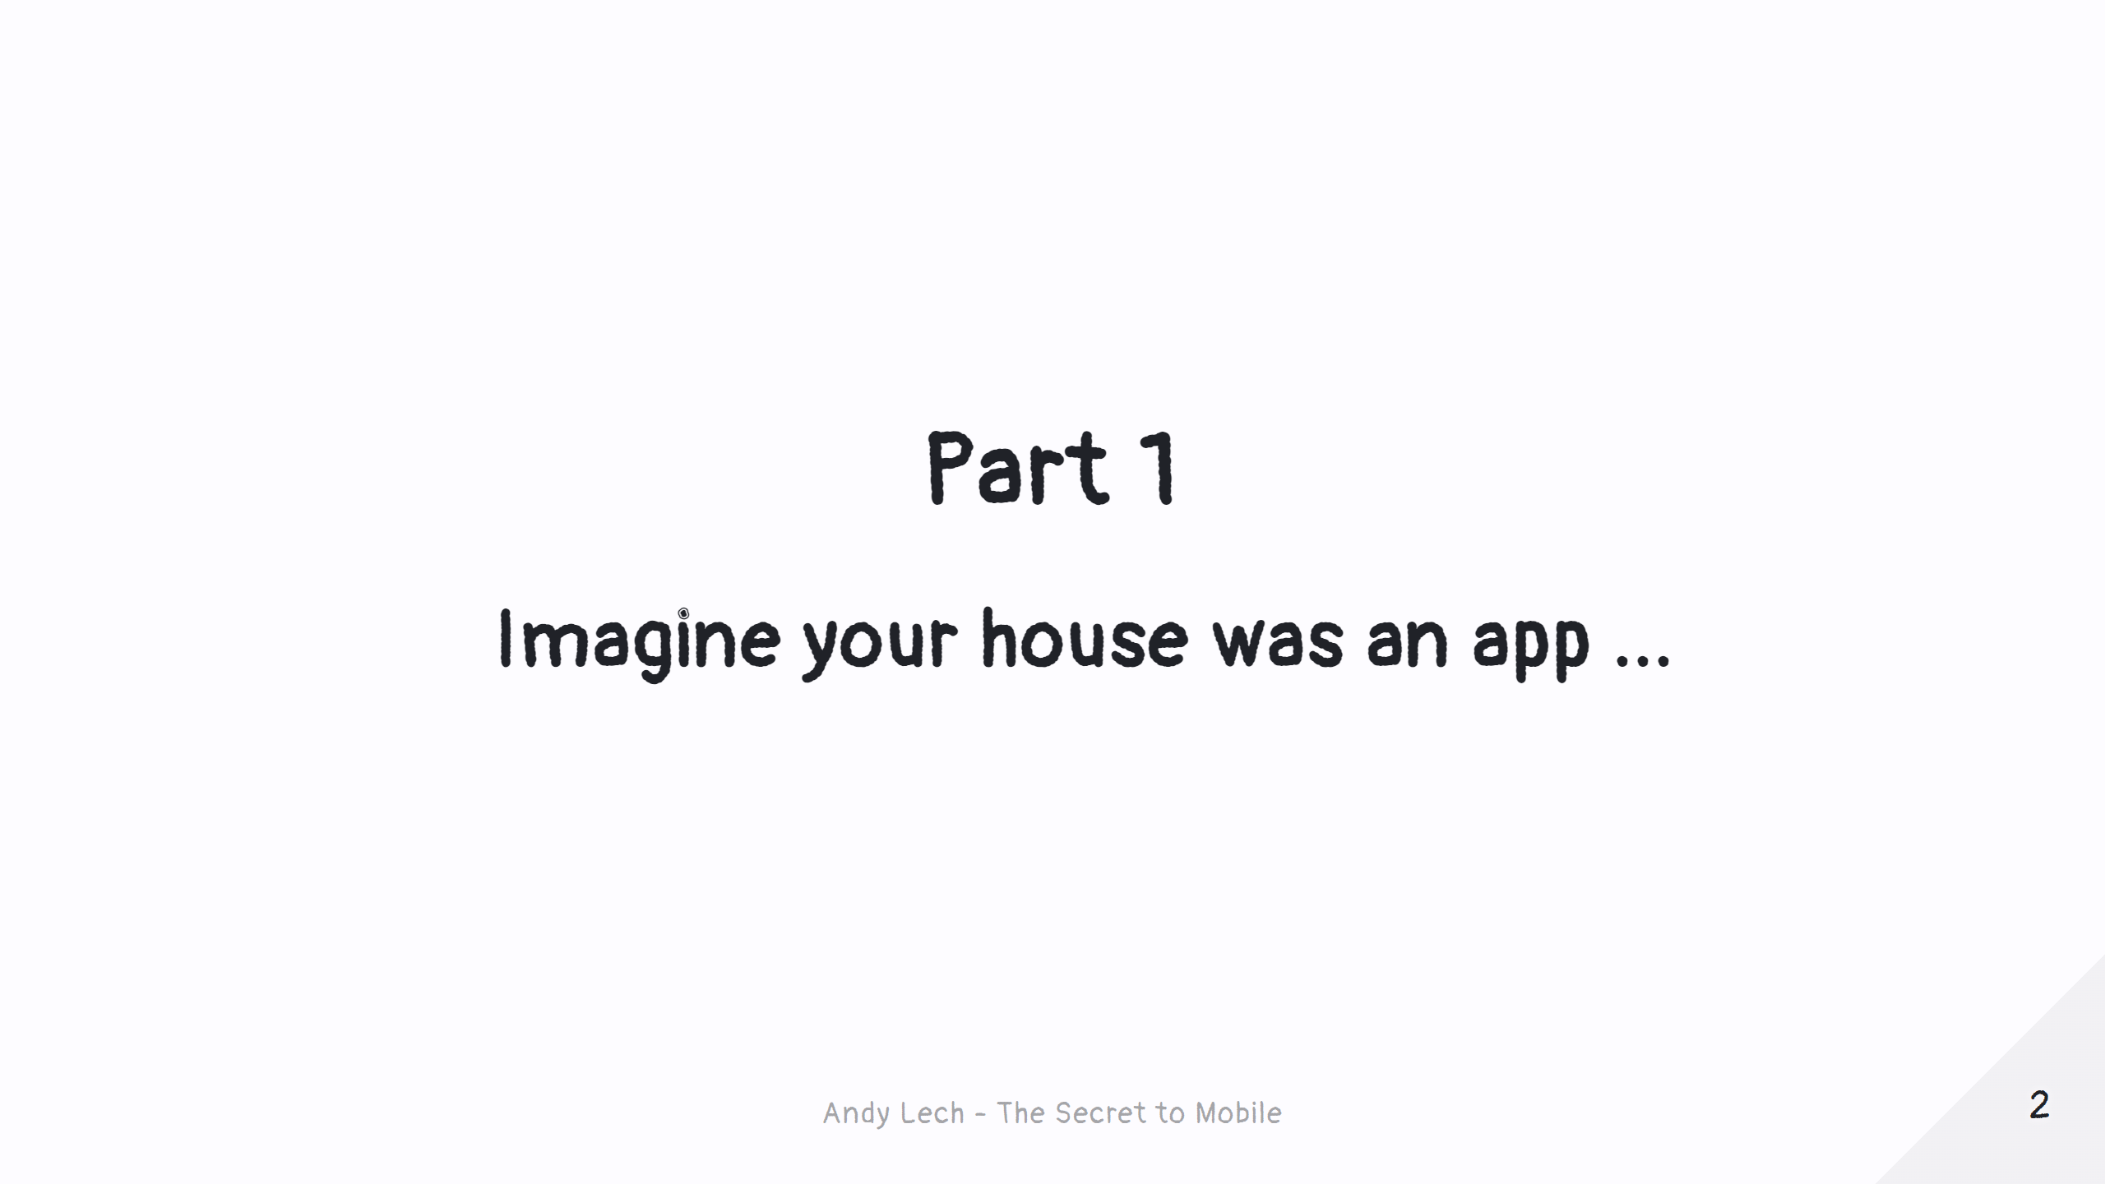
Notes:
Page 1 - Title

Slide 4
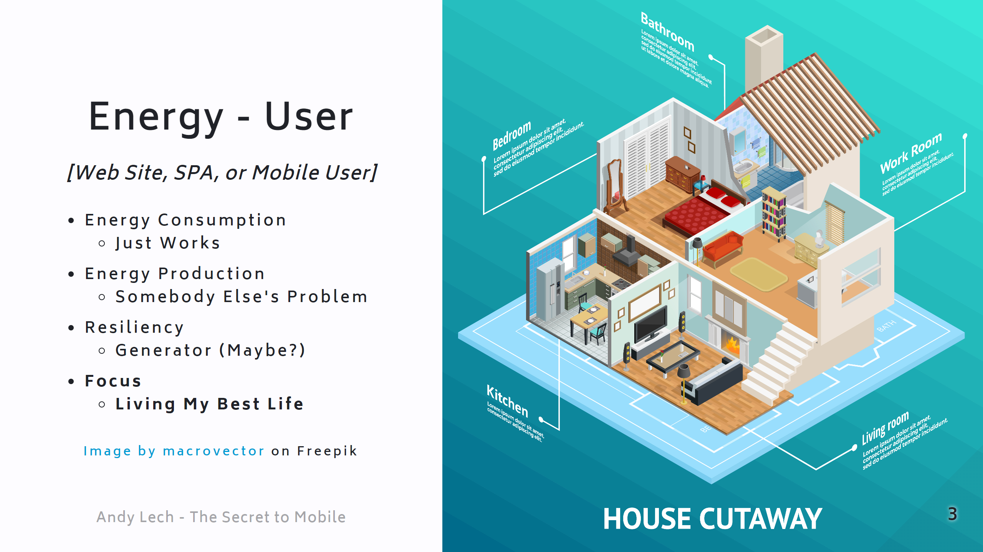
Notes:
Page 1 - House - User

Slide 5
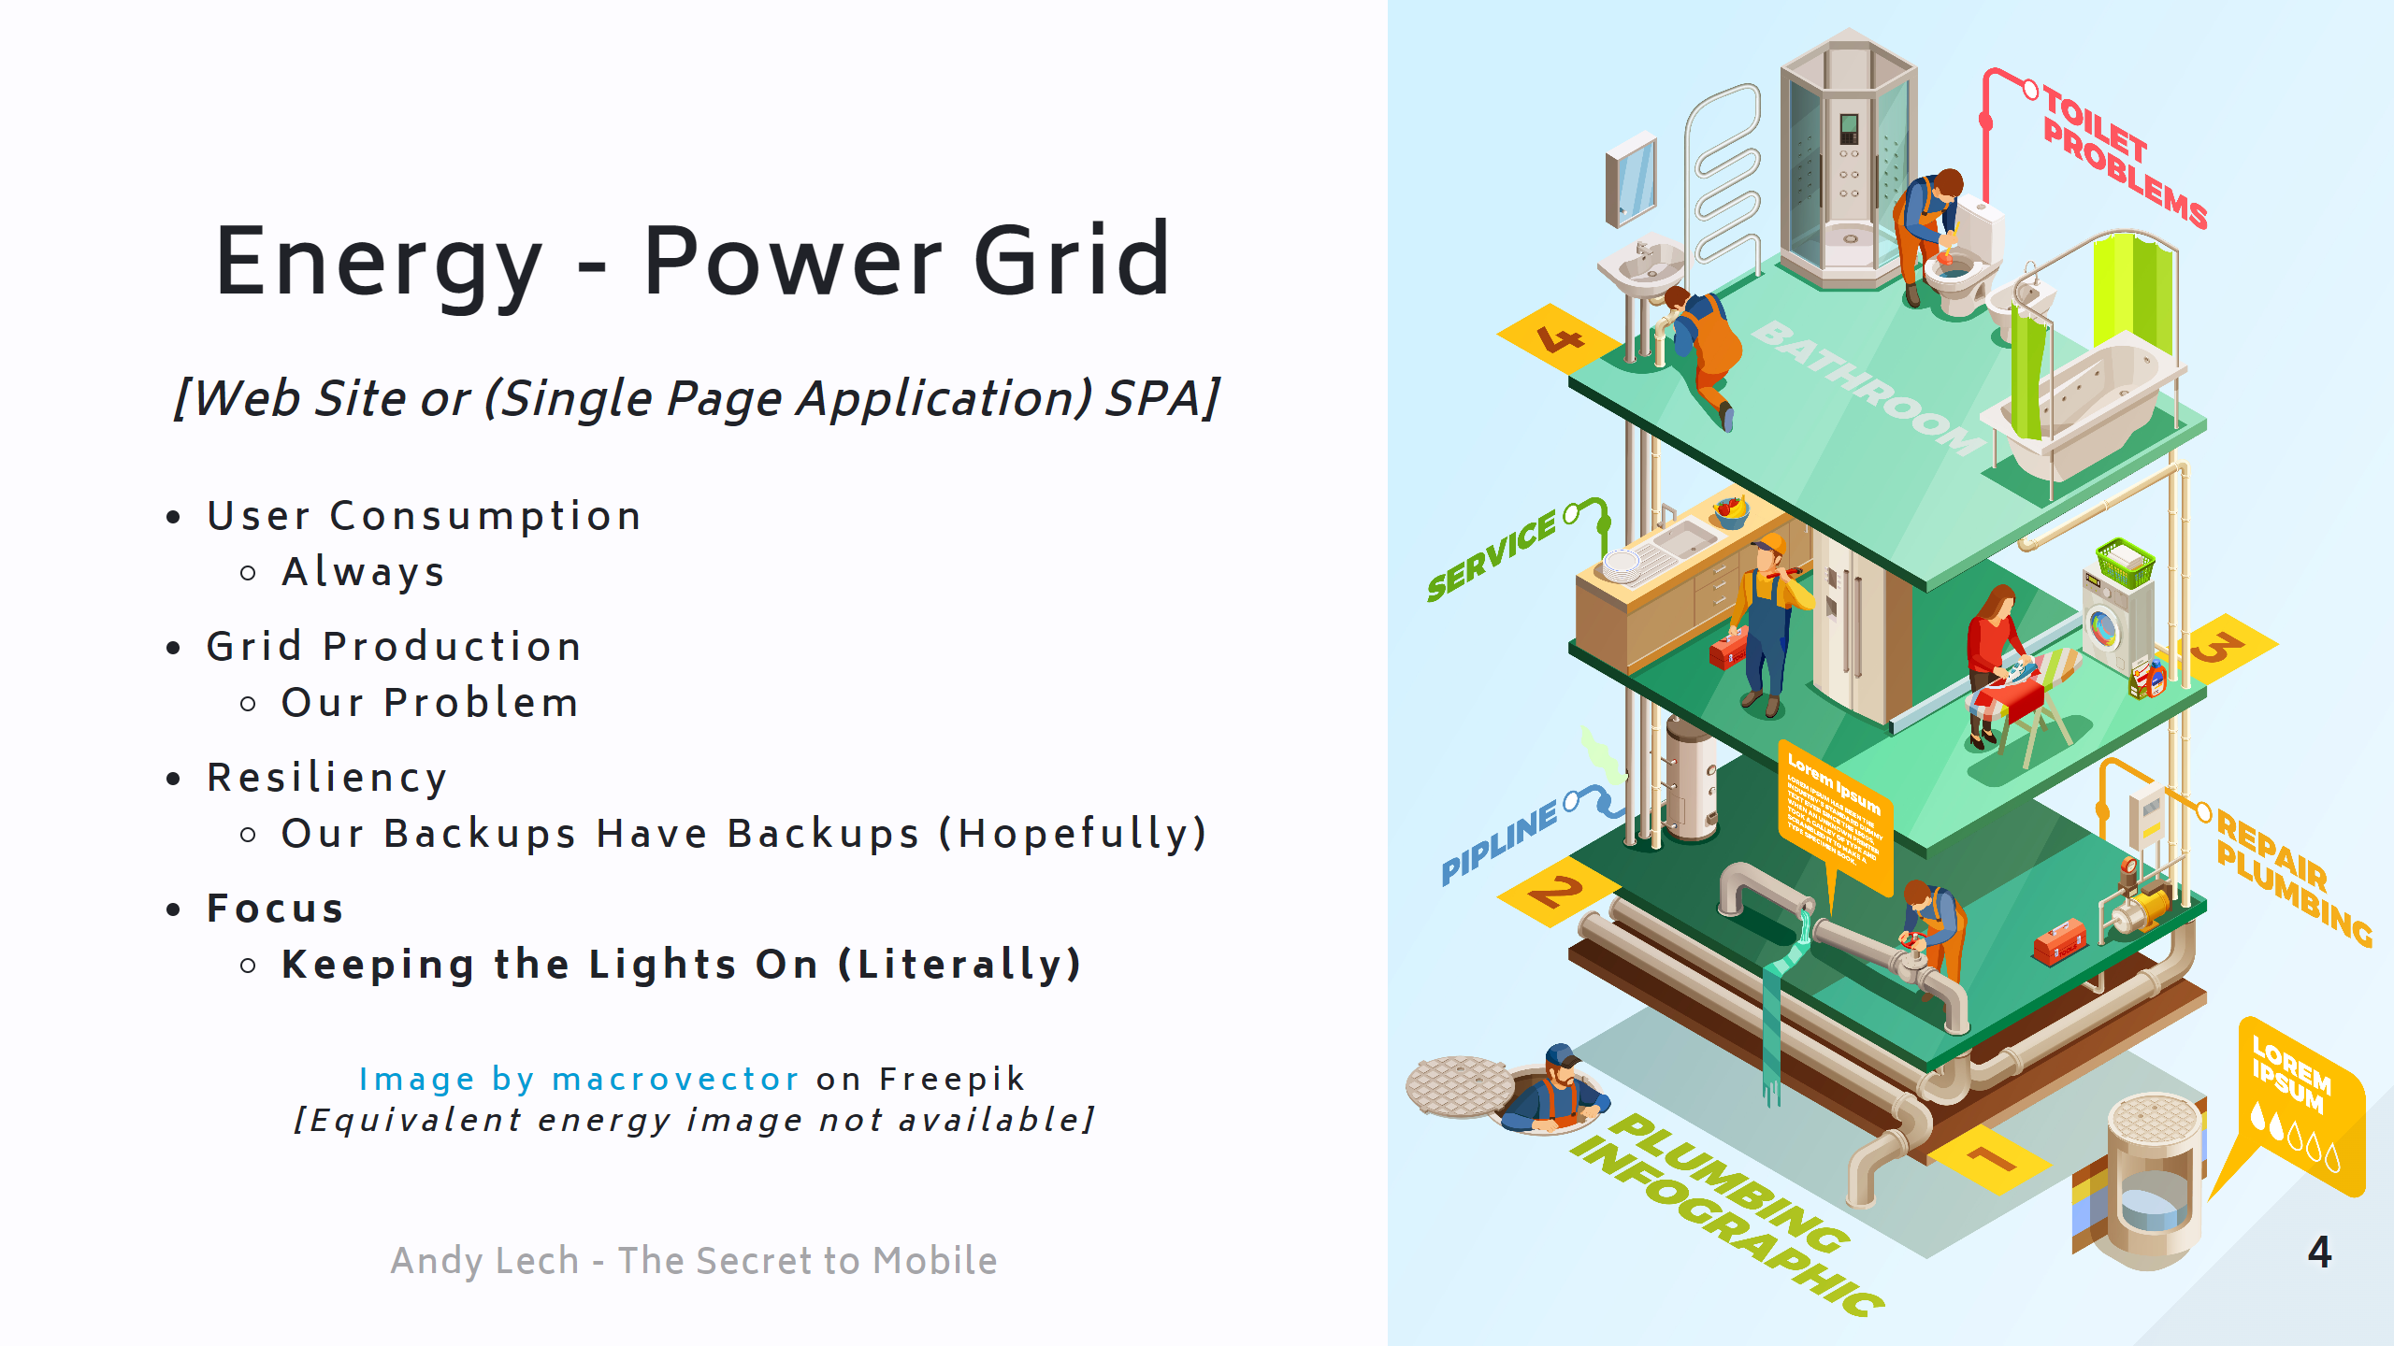
Notes:
Page 1 - House - Grid

Slide 6
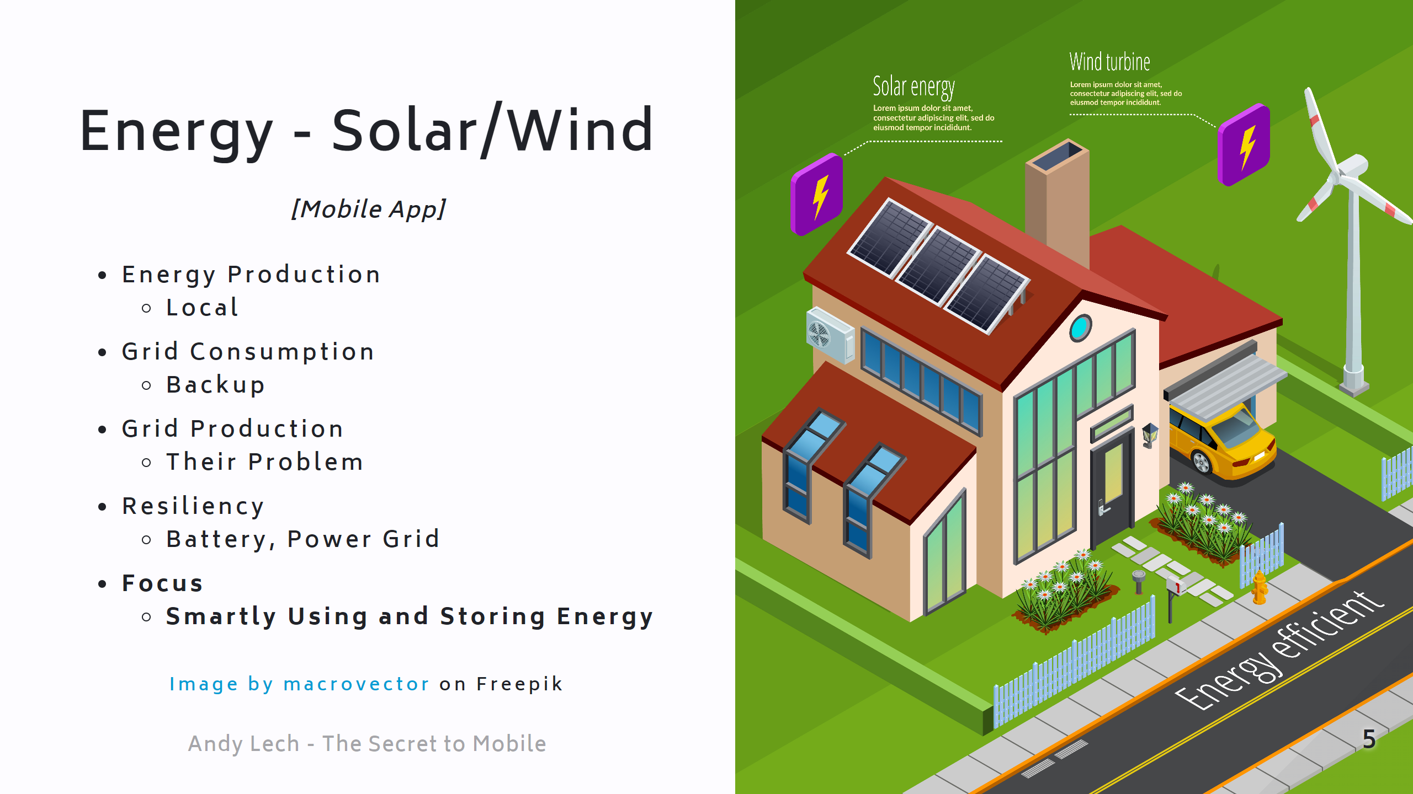
Notes:
Page 1 - House - Solar

Slide 7
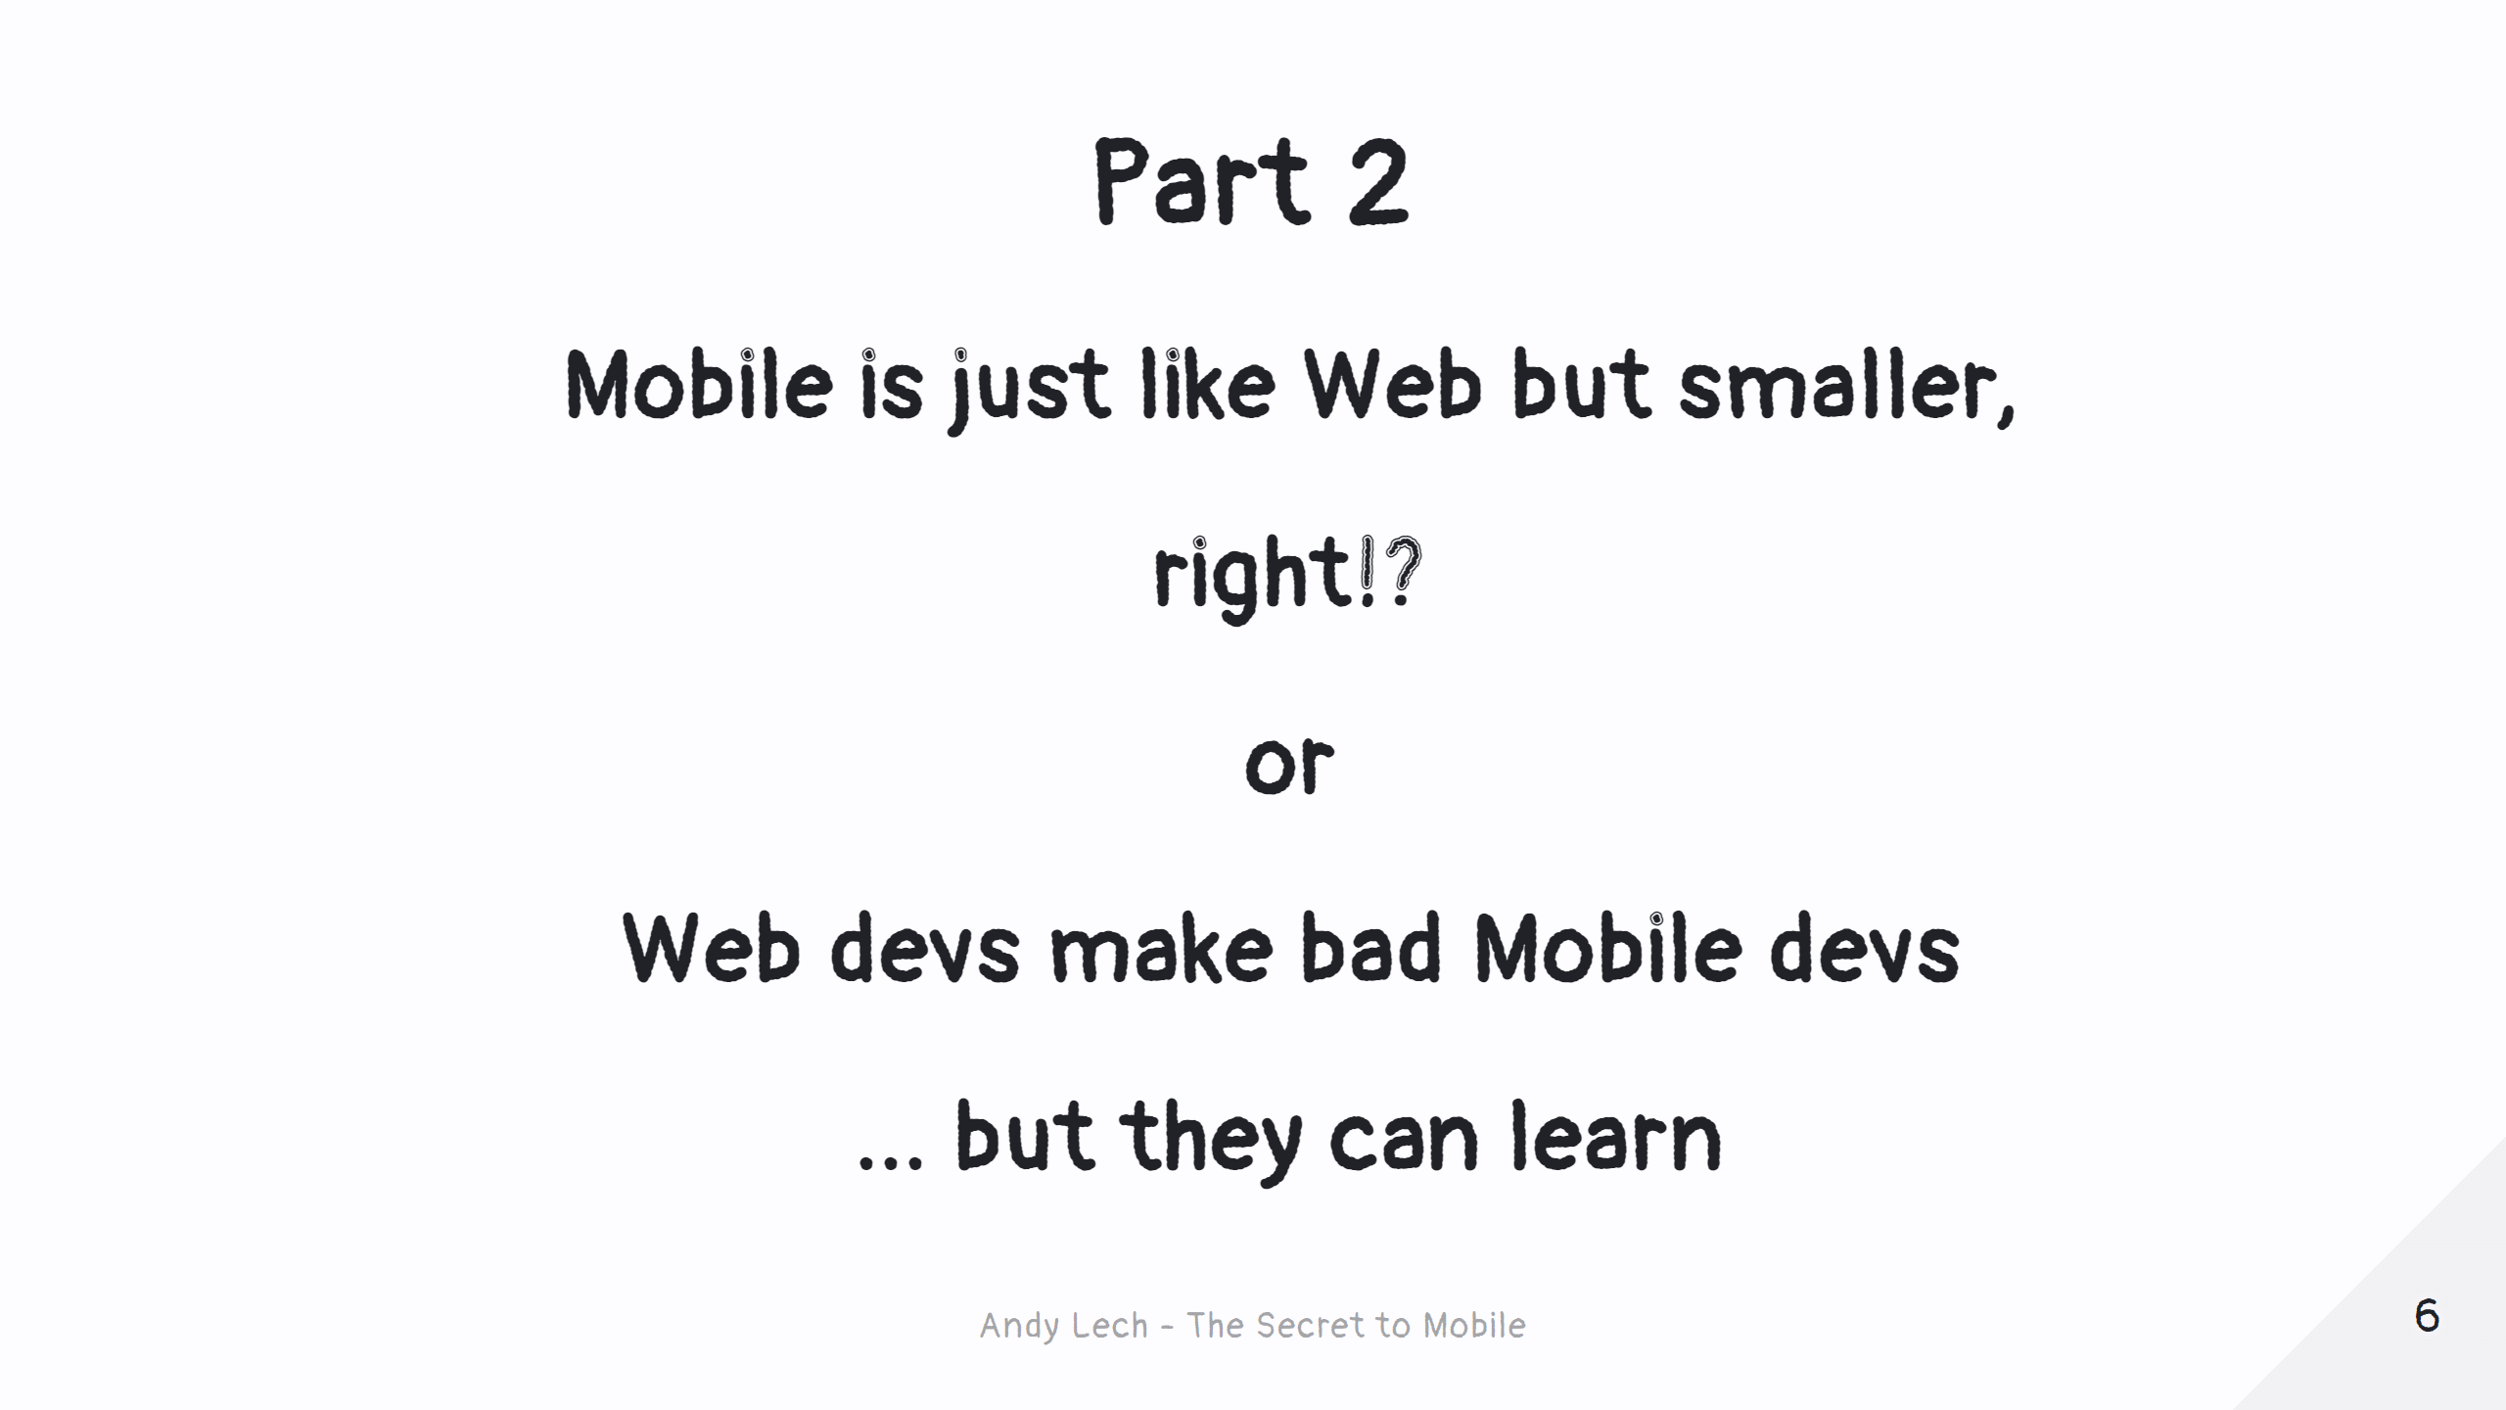
Notes:
Page 2 - Title

Slide 8
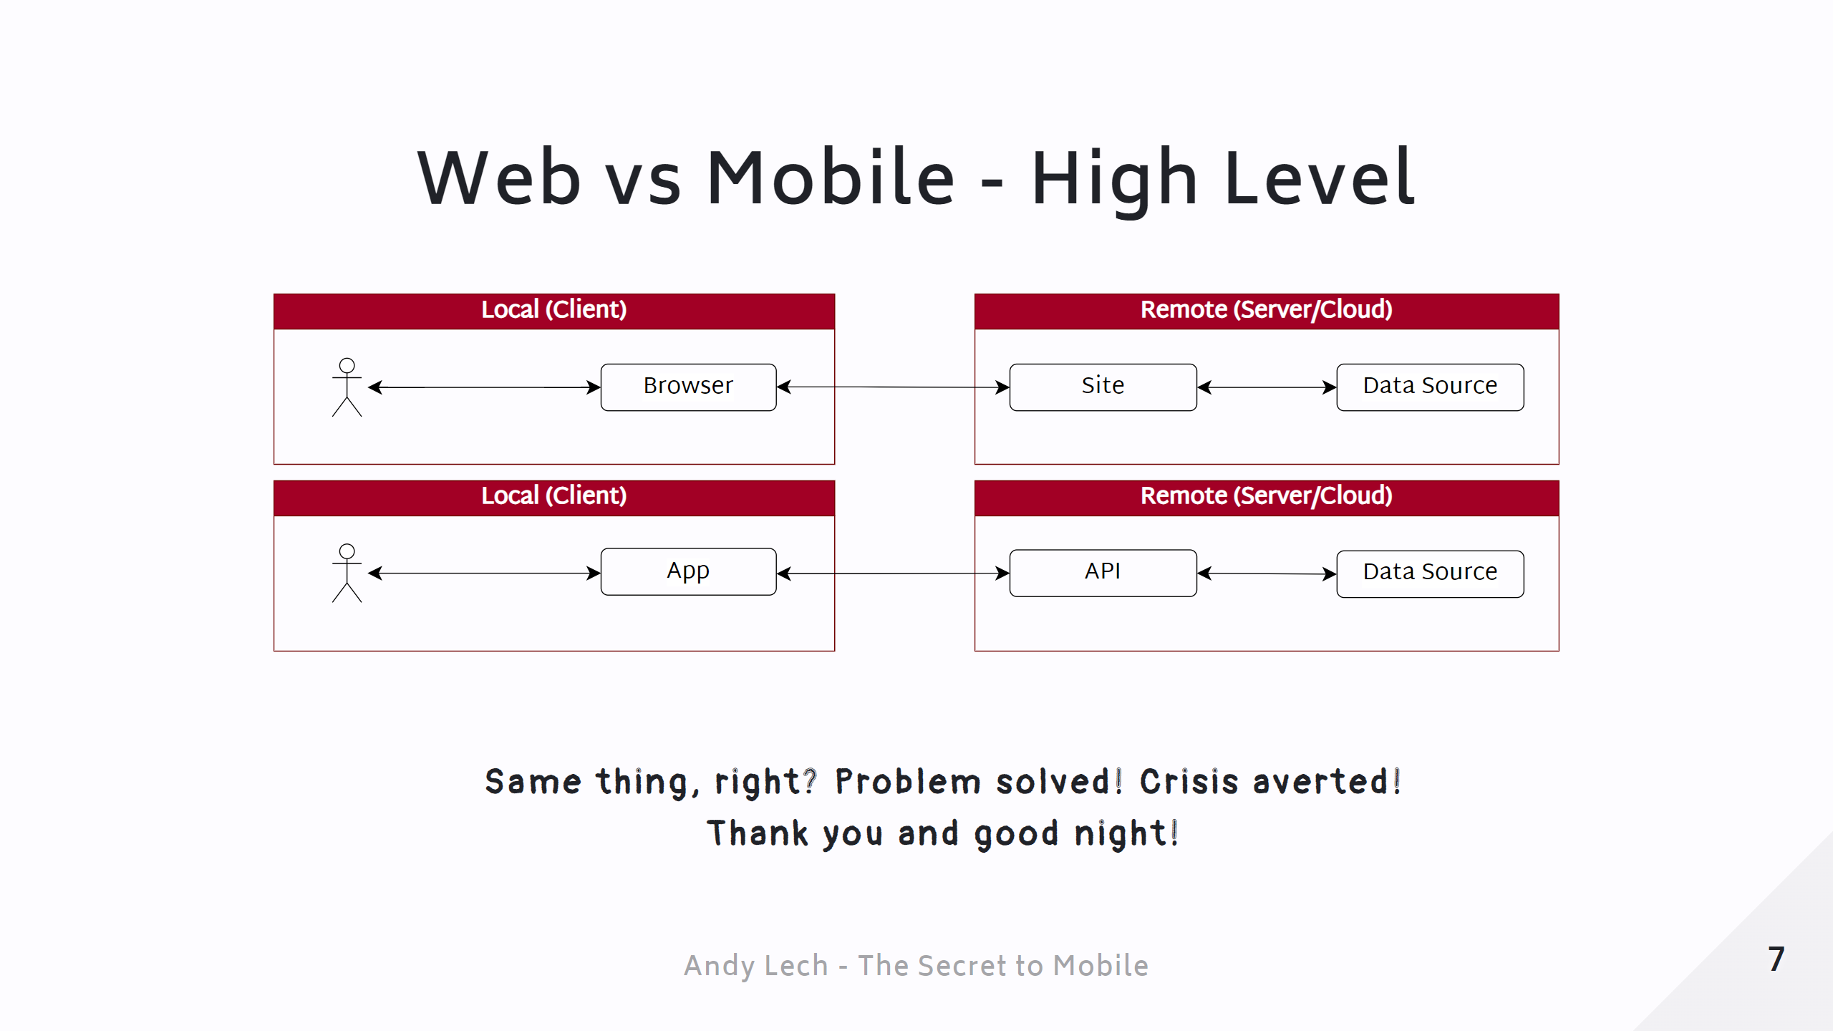
Notes:
Page 7 - Web vs Mobile - High-level

Slide 9
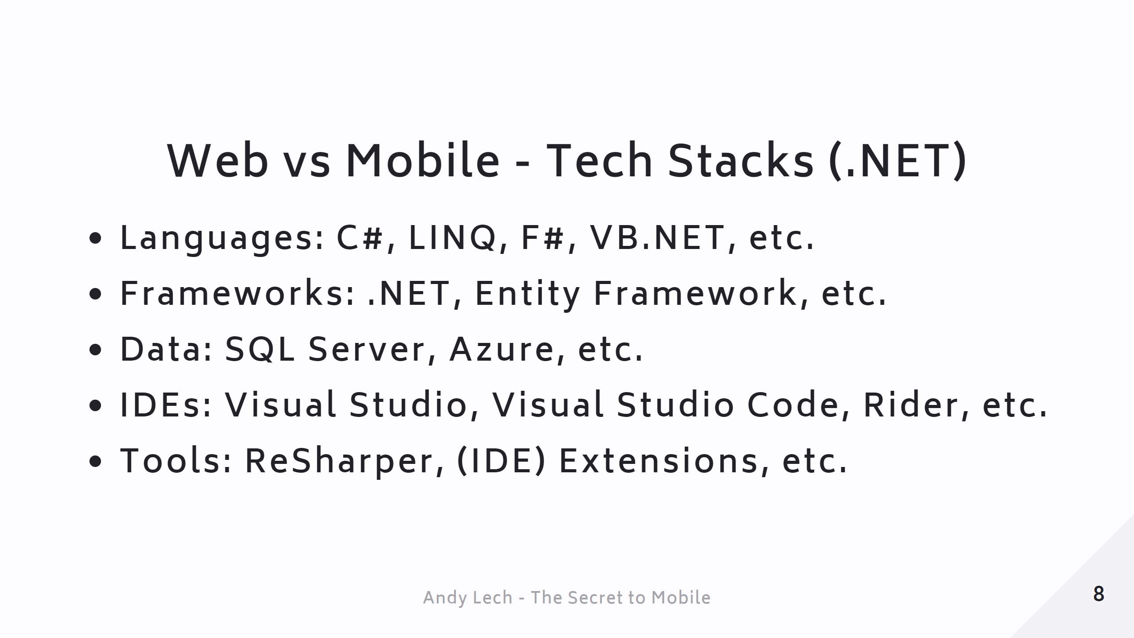
Notes:
Page 8 - Web vs Mobile - Tech Stack (.NET)

Slide 10
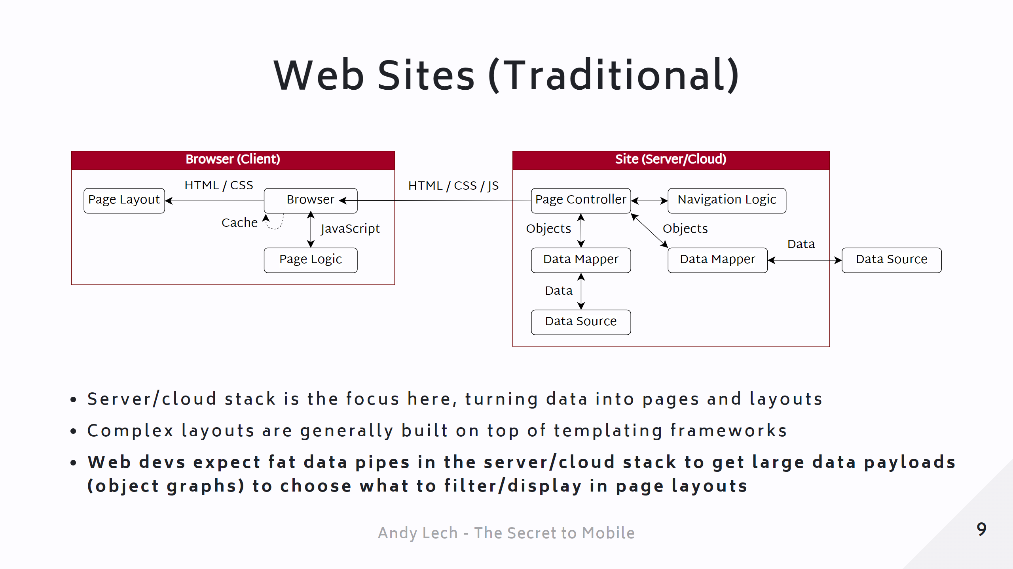
Notes:
Page 9 - Web Sites (Traditional) - Architecture

Slide 11
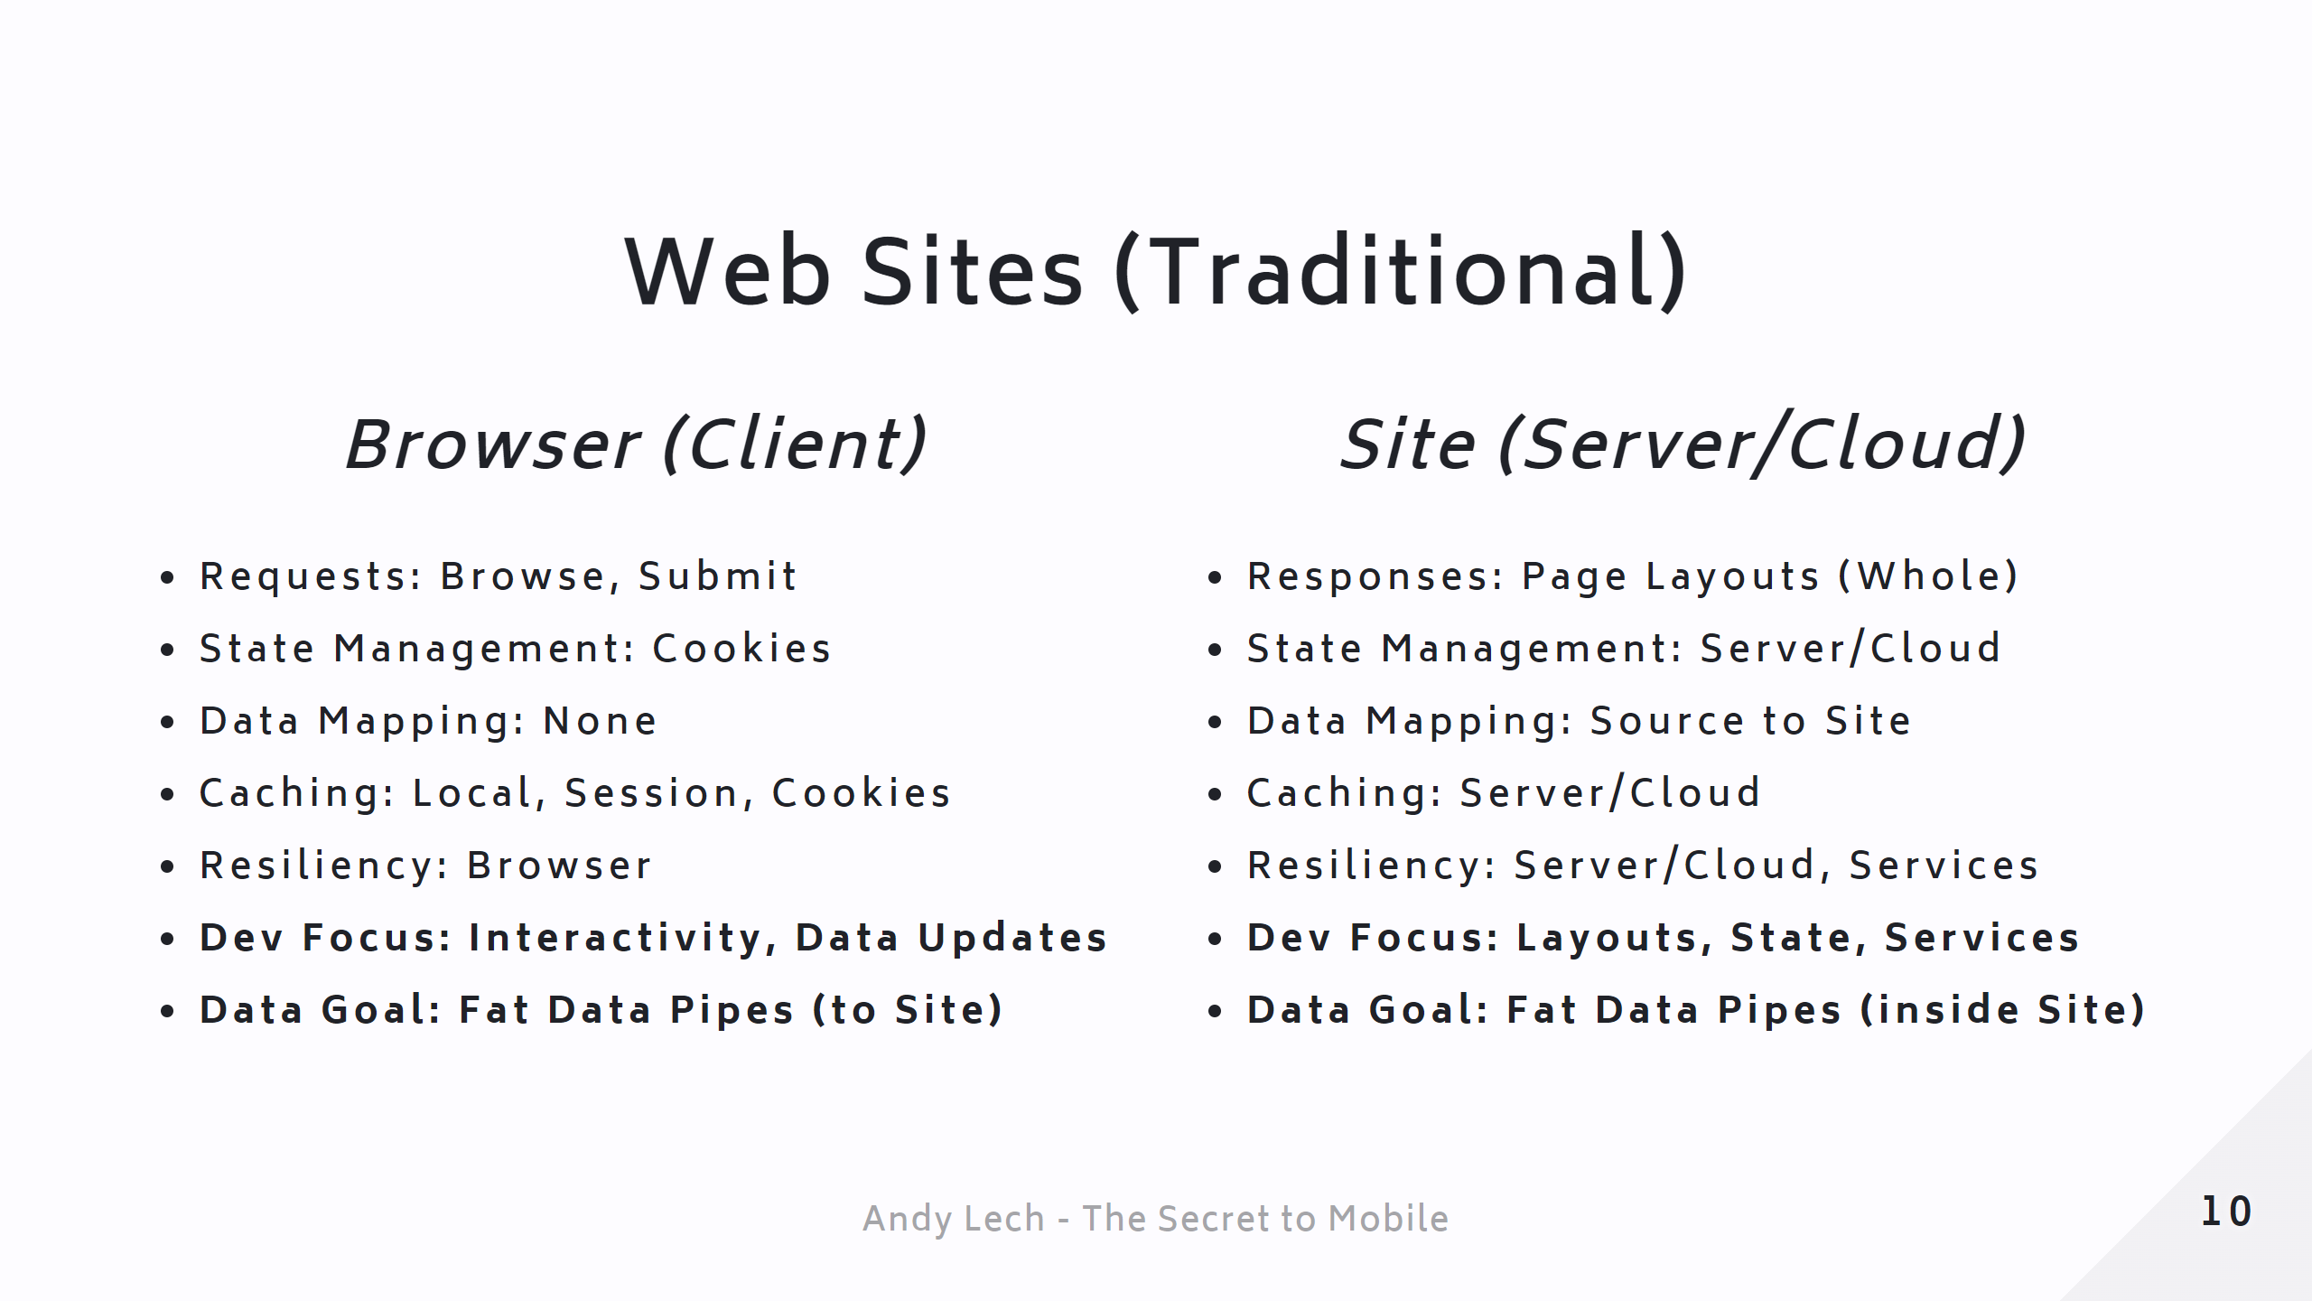
Notes:
Page 10 - Web Sites (Traditional) - Summary

Slide 12
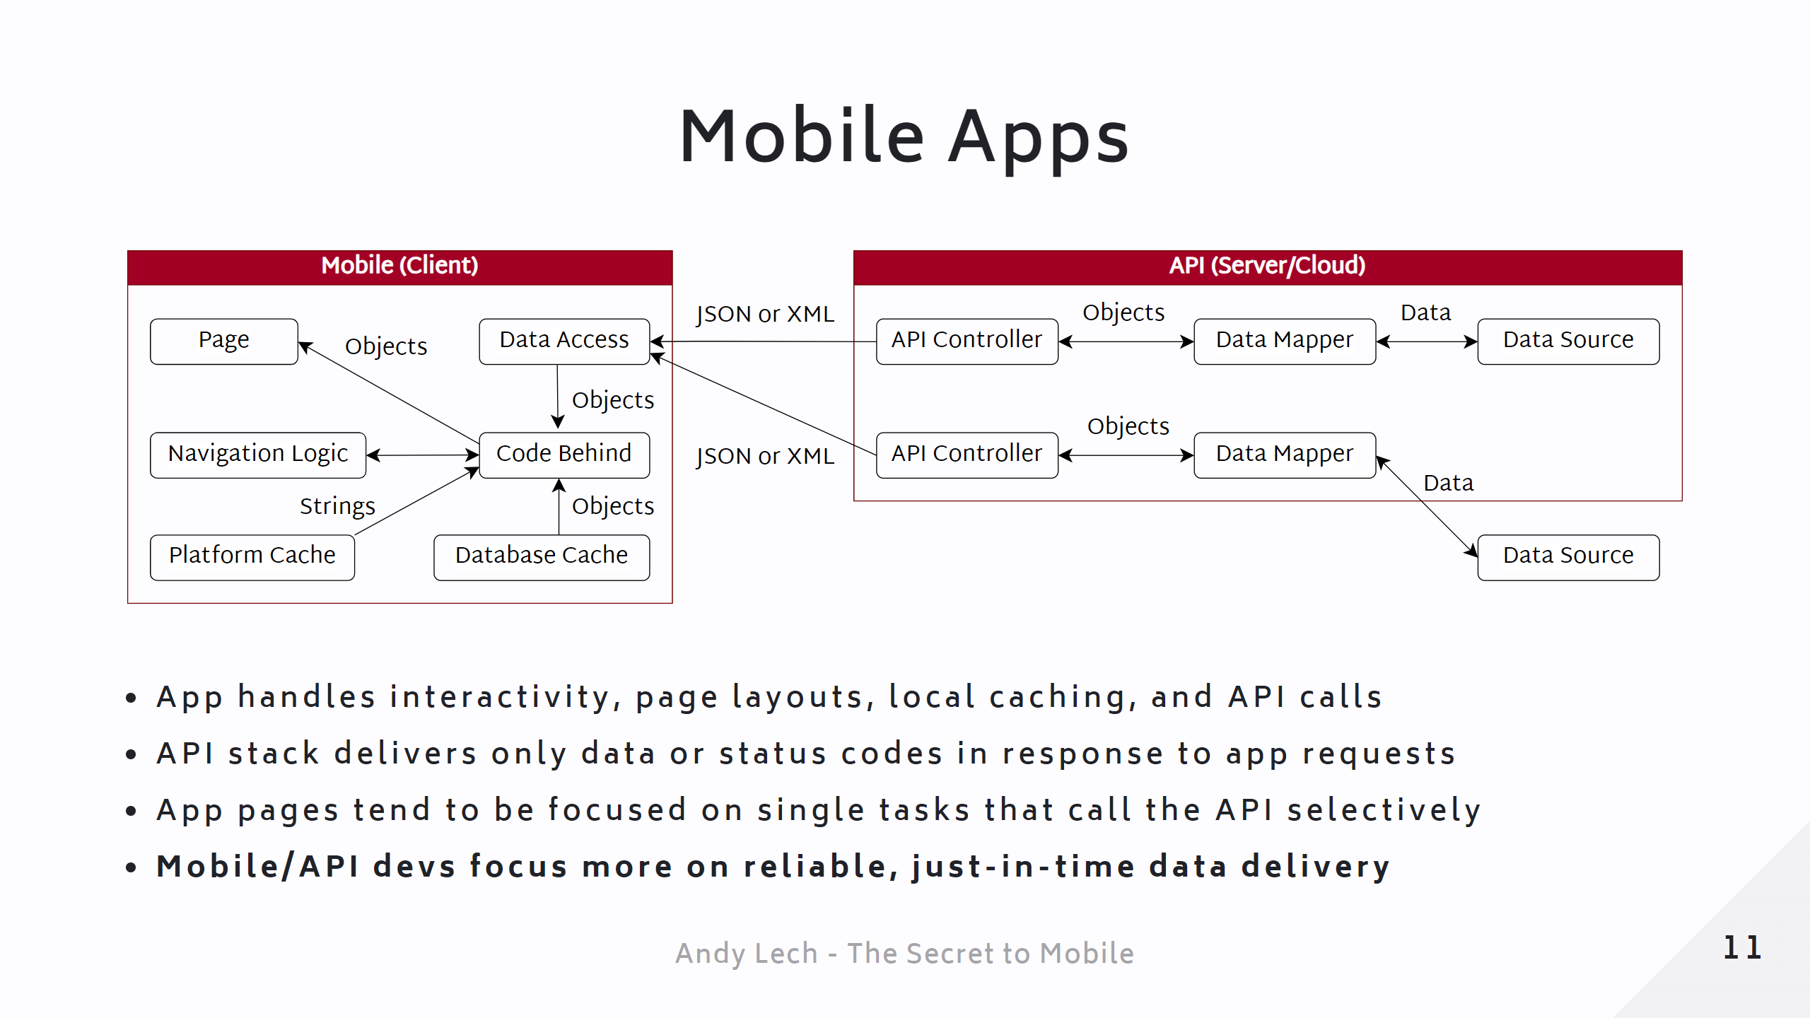
Notes:
Page 13 - Mobile Apps - Architecture

Slide 13
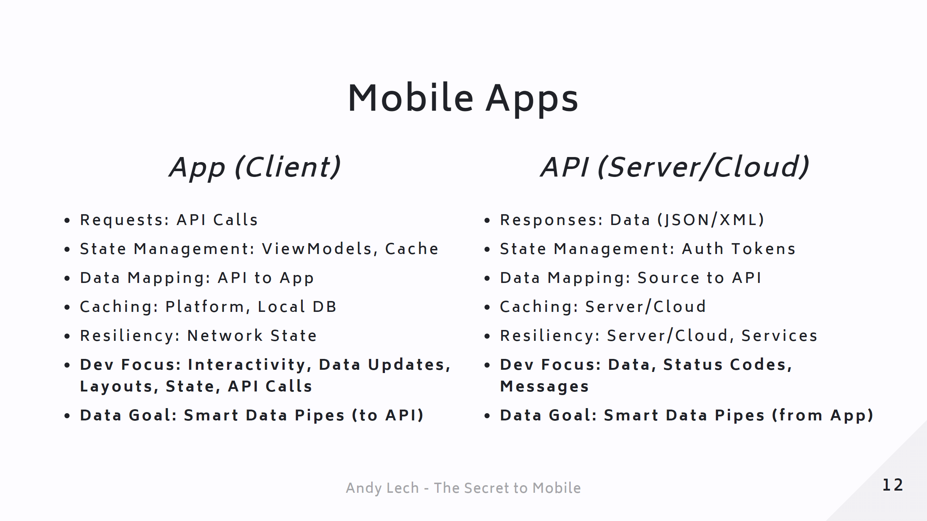
Notes:
Page 14 - Mobile Apps - Summary

Slide 14
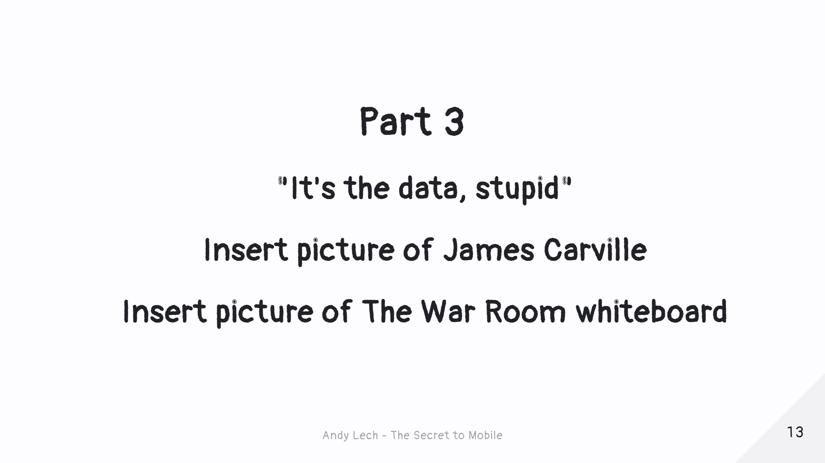
Notes:
Page 15 - Part 3 Title

Slide 15
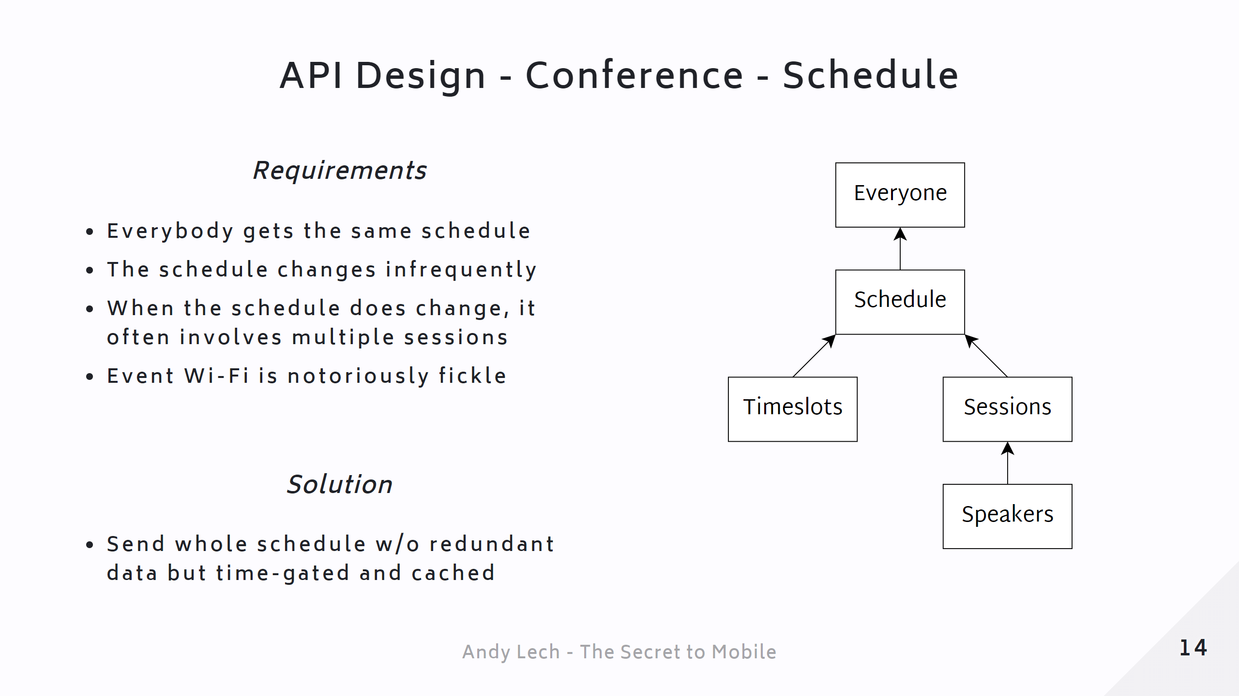
Notes:
Page 16 - API Design - Conference - Schedule <div class="mermaid"> %%{init: {'theme': 'neutral', 'themeVariables': {'labelBackgroundColor': 'transparent'}}}%% classDiagram Everybody -- Schedule Schedule <.. Timeslots Schedule <.. Sessions Schedule <.. Speakers </div>

Slide 16
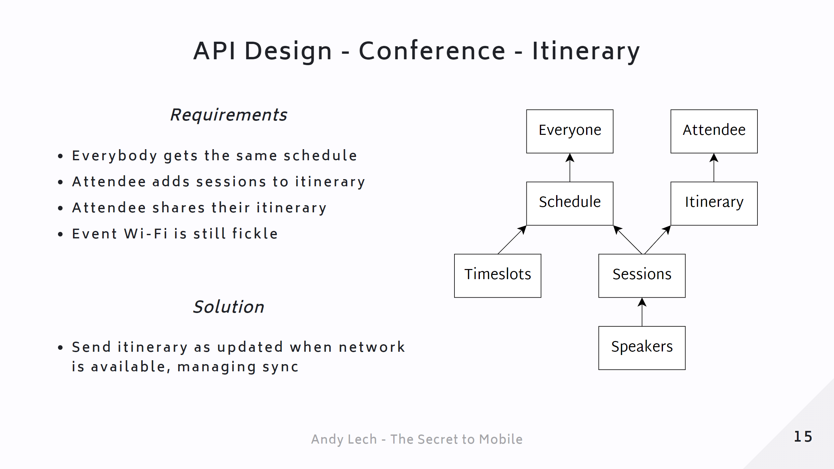
Notes:
Page 17 - API Design - Conference - Itinerary <div class="mermaid"> %%{init: {'theme': 'neutral', 'themeVariables': {'labelBackgroundColor': 'transparent'}}}%% classDiagram Individual -- Calendar Individual -- Schedule Calendar <.. Sessions Schedule <.. Timeslots Schedule <.. Sessions Schedule <.. Speakers </div>

Slide 17
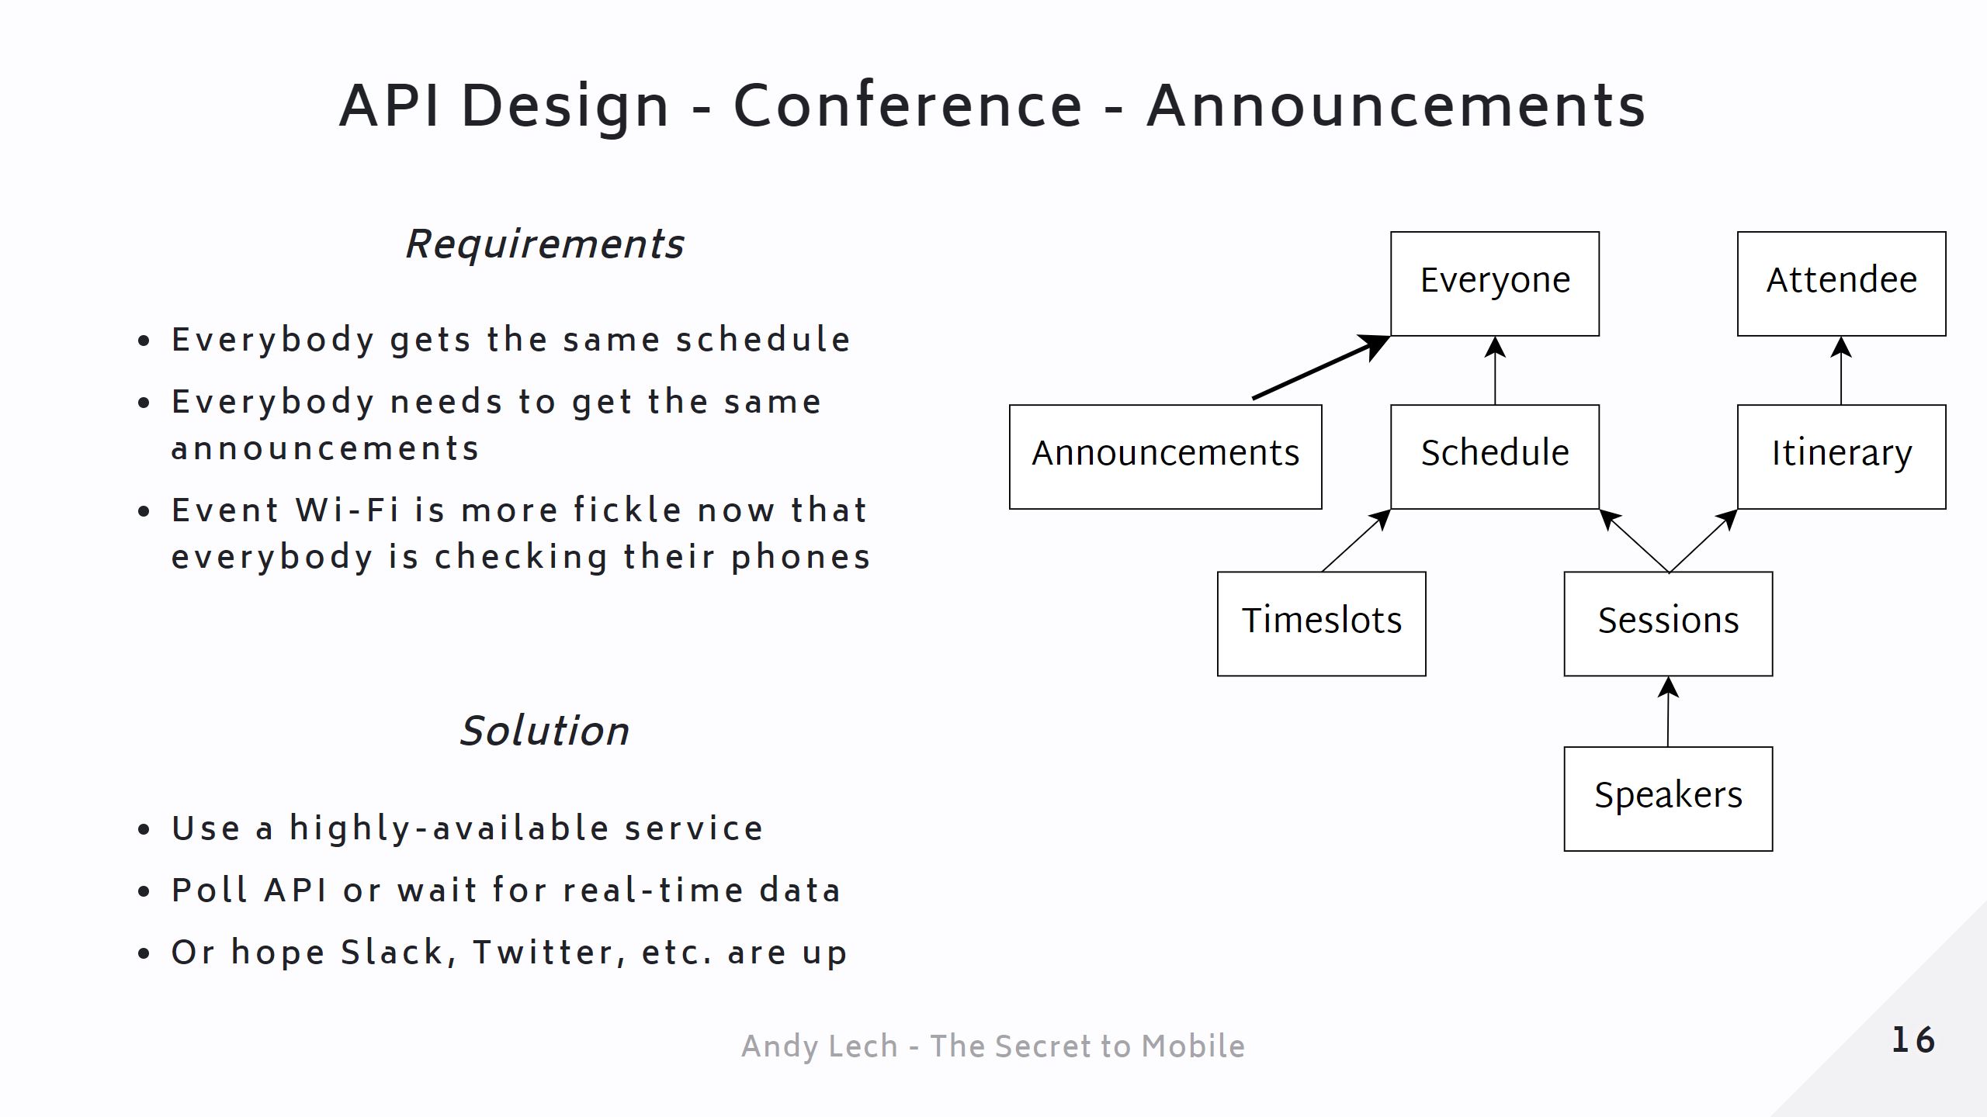
Notes:
Page 18 - API Design - Conference - Announcements <div class="mermaid"> %%{init: {'theme': 'neutral', 'themeVariables': {'labelBackgroundColor': 'transparent'}}}%% classDiagram Individual -- Announcements Individual -- Calendar Individual -- Schedule Calendar <.. Sessions Schedule <.. Timeslots Schedule <.. Sessions Schedule <.. Speakers </div>

Slide 18
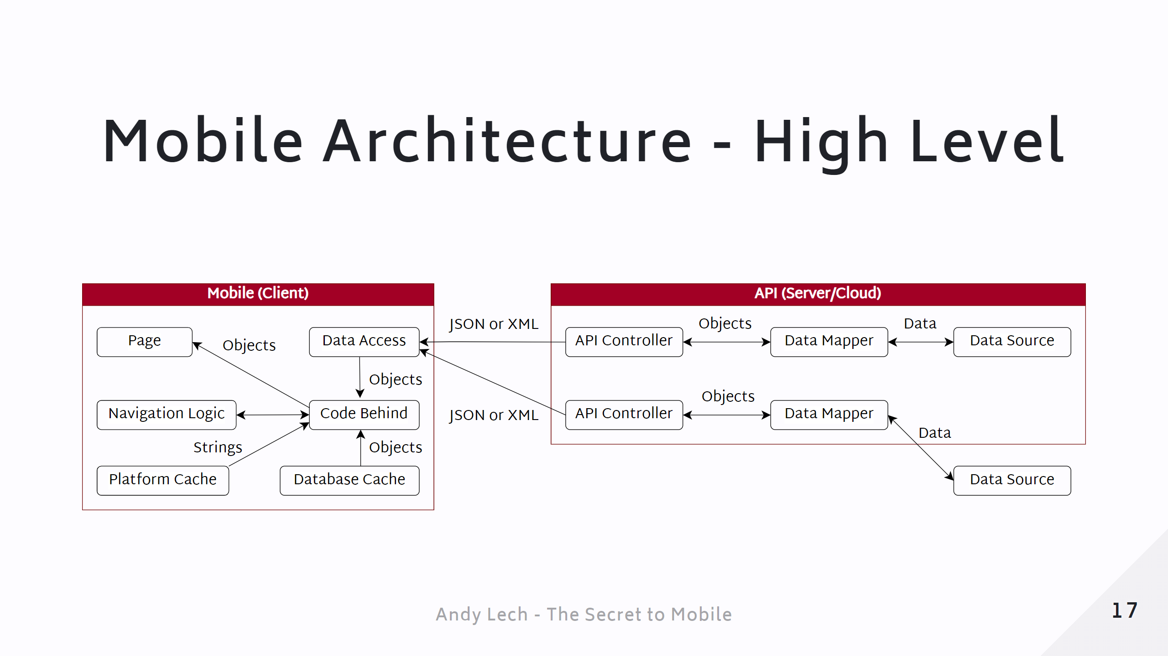
Notes:
Page 19 - Mobile Architecture - High-Level

Slide 19
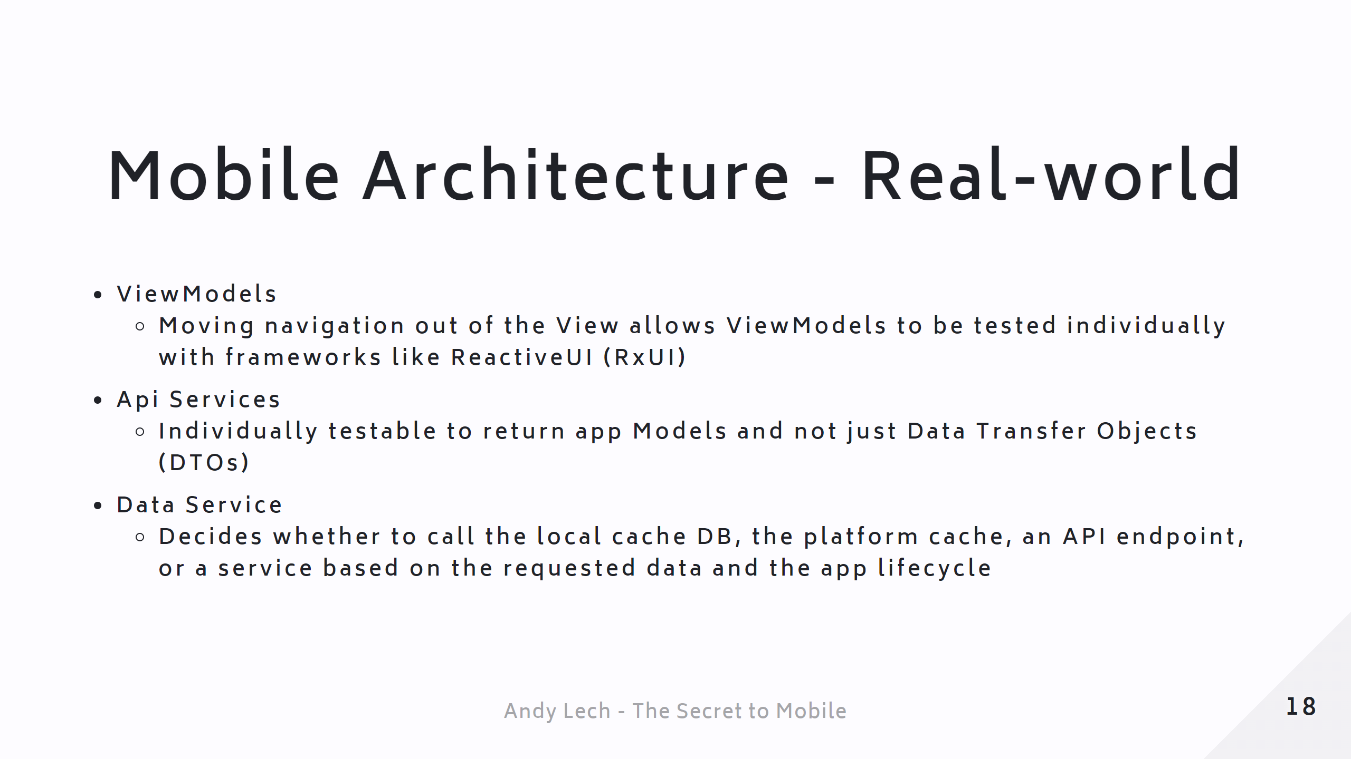
Notes:
Page 21 - Mobile Architecture - Real World (cont.)

Slide 20
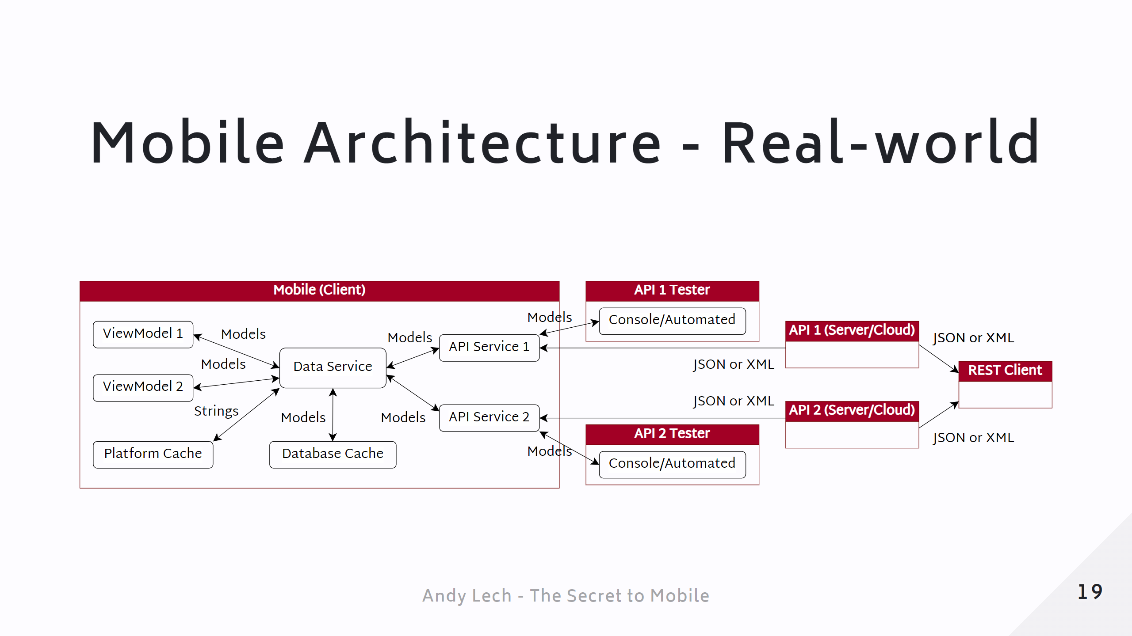
Notes:
Page 22 - Mobile Architecture - Real World

Slide 21
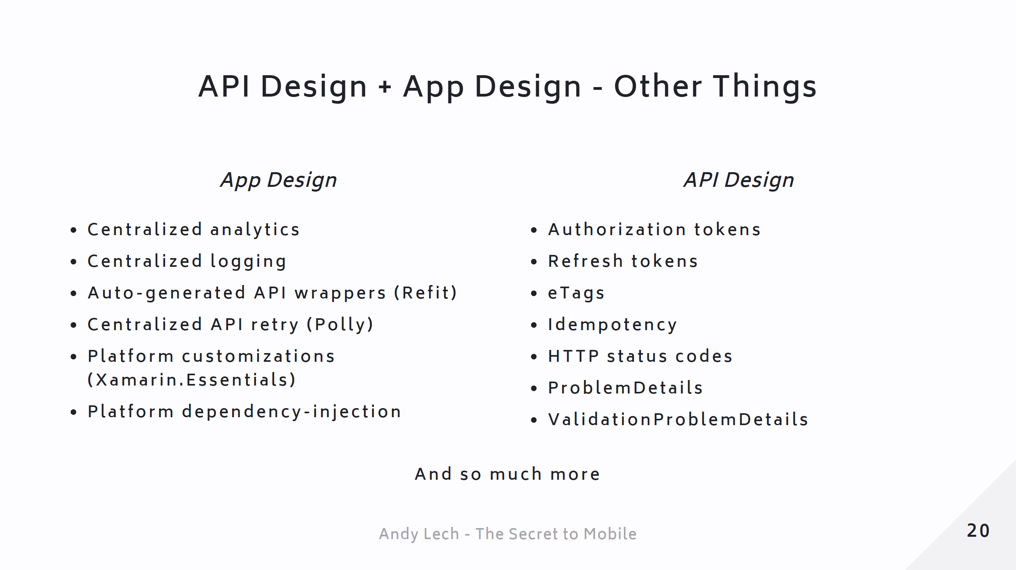
Notes:
Page 23 - API Design + App Design - Other Things

Slide 22
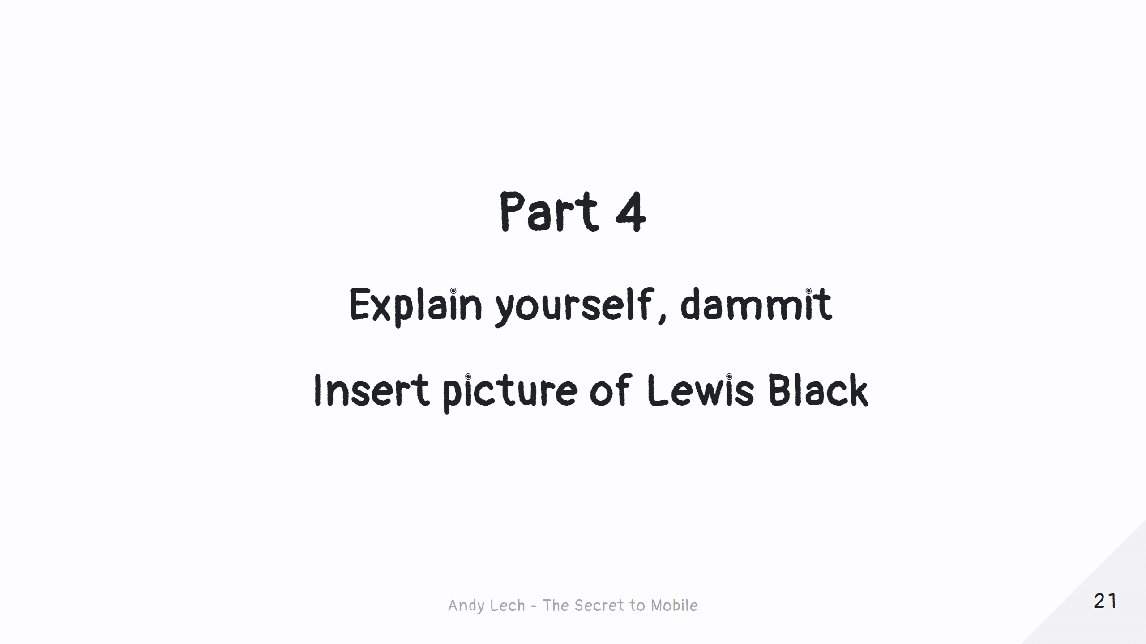
Notes:
Page 24 - Part 4 Title

Slide 23
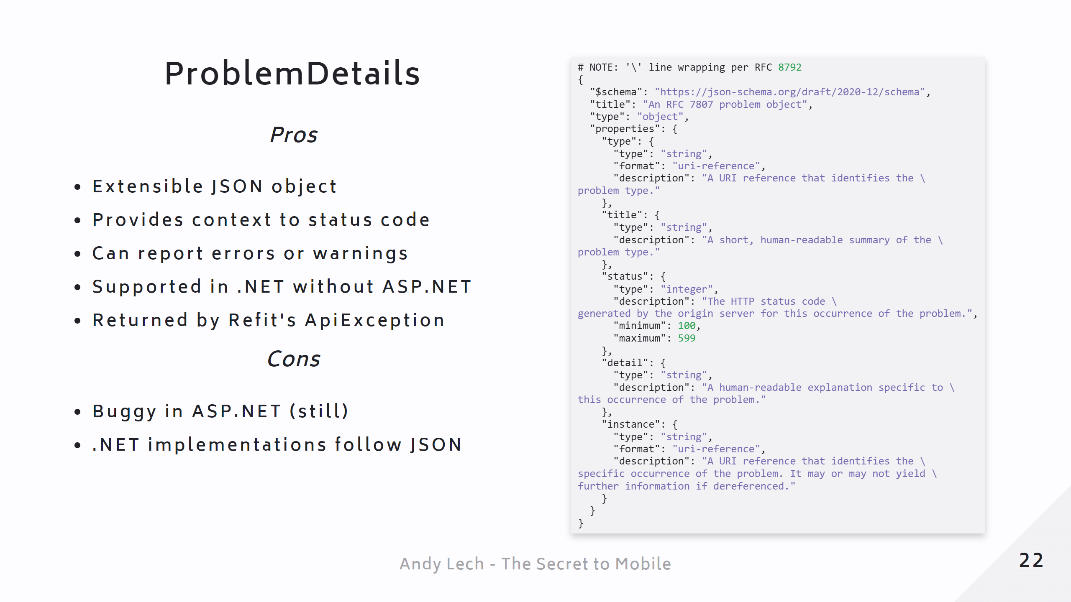
Notes:
Page 25 - ProblemDetails Page 26 - Demo - ProblemReports (PdHelpers) # _class: details ### Demo - ProblemReports (PdHelpers)

Slide 24
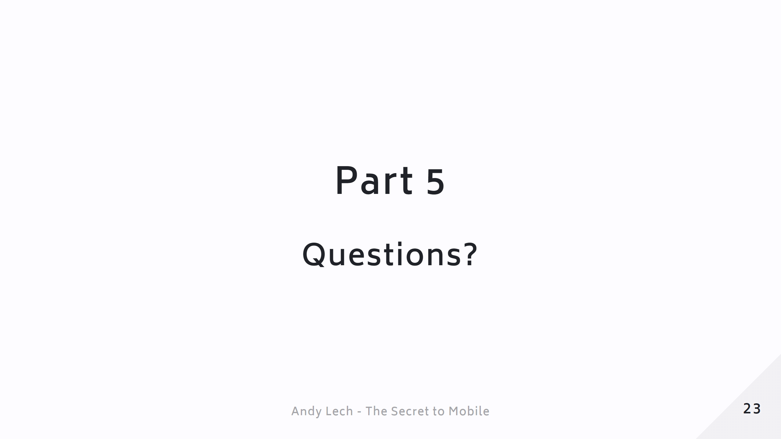
Notes:
Page 27 - Questions?

